Slide 1
Log on @ Lunch Cybersecurity Awareness Month
10/19/21
Bryan McLaughlin
DoIT

Slide 2
Agenda
The most common security mistakes that are seen on campus.
Not understanding Phishing
Easy to guess passwords
Not using a password vault
What the Division of IT is doing to protect the campus.
Continuing Security Awareness Training
Student MFA
Security Operations Center
Improved vulnerability management
Enhanced network security
Improved Identity and Access Management
Information Security

Slide 3
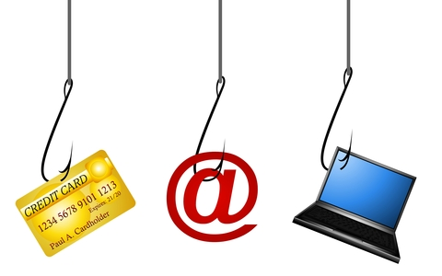
Phishing
The fraudulent practice of sending emails purporting to be from reputable companies in order to induce individuals to reveal personal information, such as passwords and credit card numbers.
Information Security

Slide 4
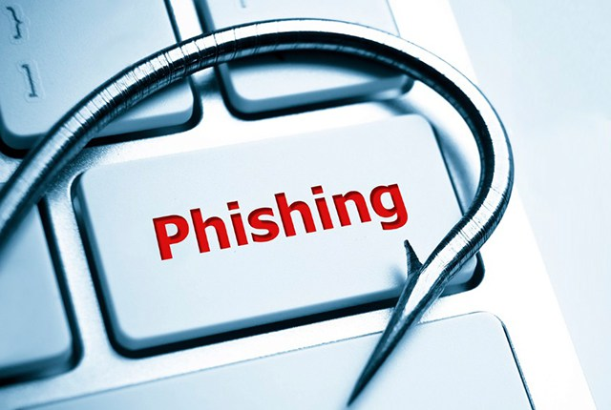
How to spot a Phishing email?
Watch for signs of a phishing email:
Suspicious From Address
Information Security

Slide 5
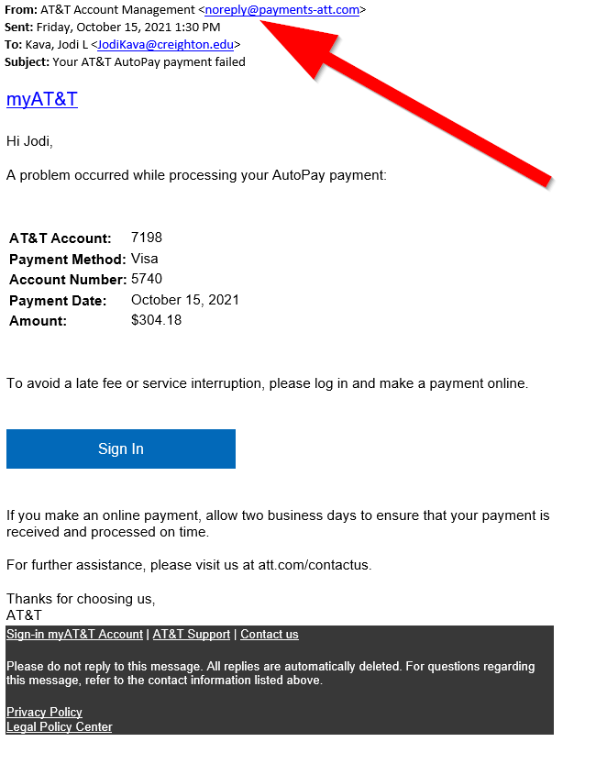
Information Security

Slide 6
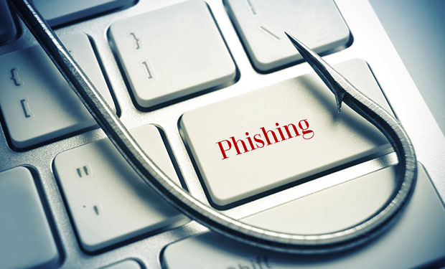
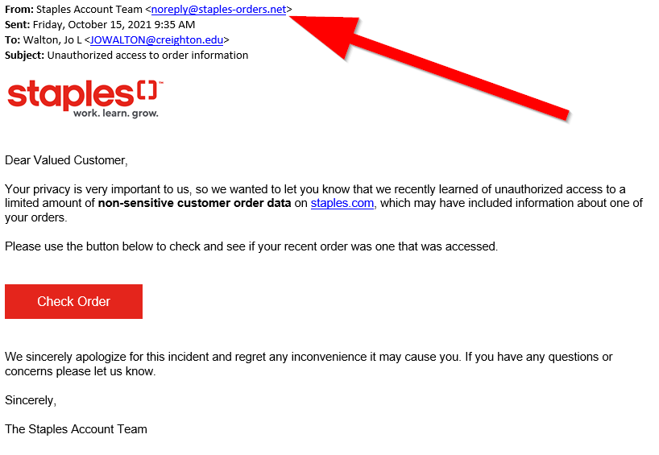
Strong Passwords
Information Security

Slide 7
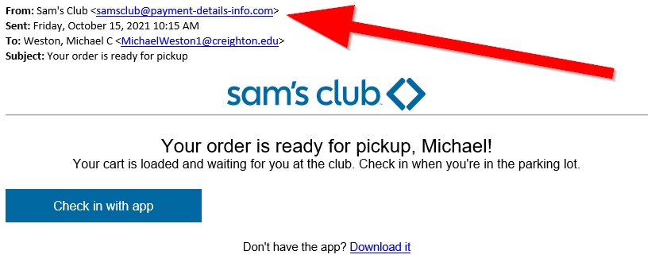
Information Security

Slide 8
How to spot a Phishing email?
Watch for signs of a phishing email:
Generic Greeting
Information Security

Slide 9
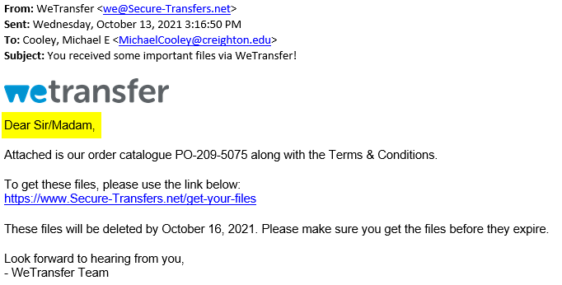
Information Security

Slide 10
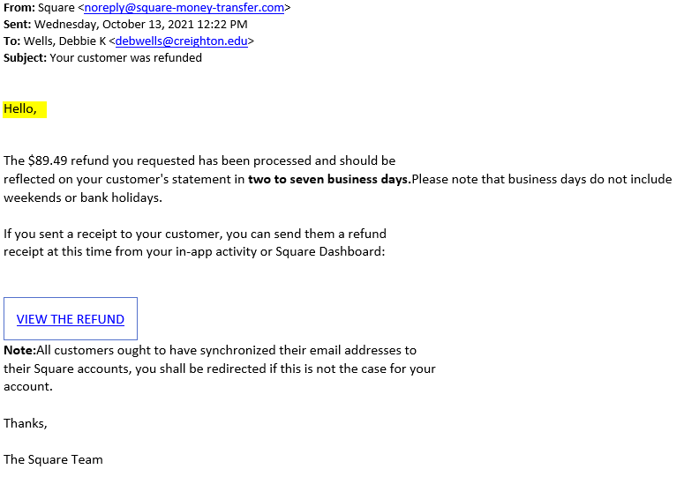
Information Security

Slide 11
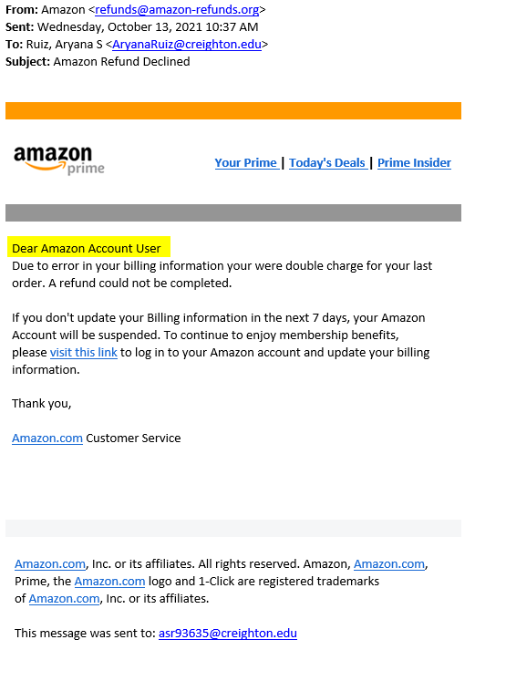
Information Security

Slide 12
How to spot a Phishing email?
Watch for signs of a phishing email:
Sense of Urgency
Information Security

Slide 15
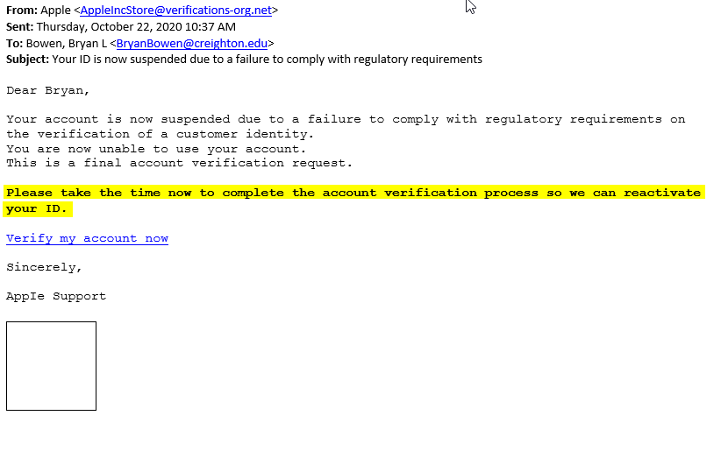

Slide 16
How to spot a Phishing email?
Watch for signs of a phishing email:
Suspicious Links
Information Security

Slide 17
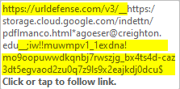
How to spot a Phishing email?
Re-written Links
Information Security

Slide 18
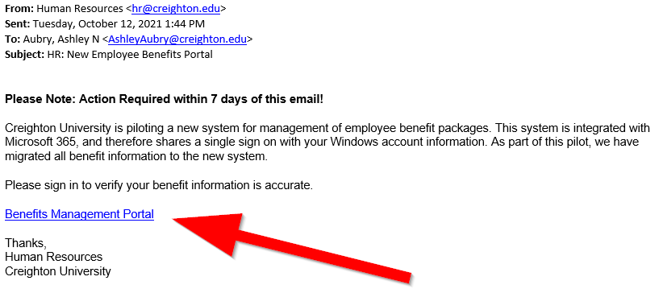
Information Security

Slide 19
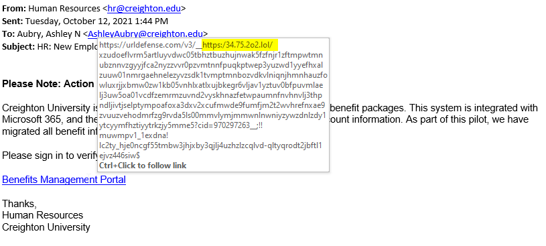
Information Security

Slide 20
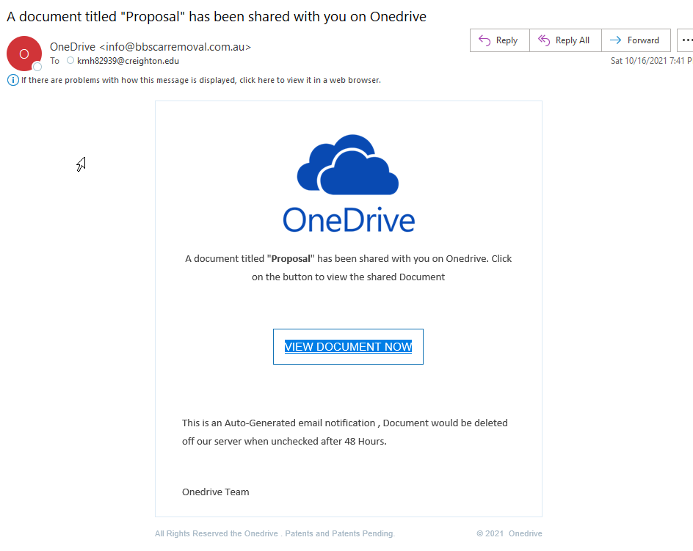
Information Security

Slide 21
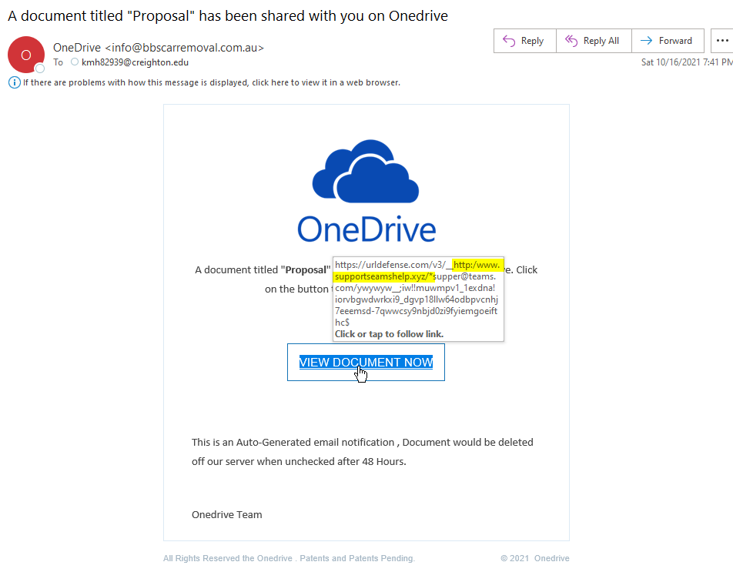
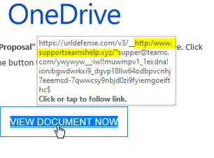
Information Security

Slide 22
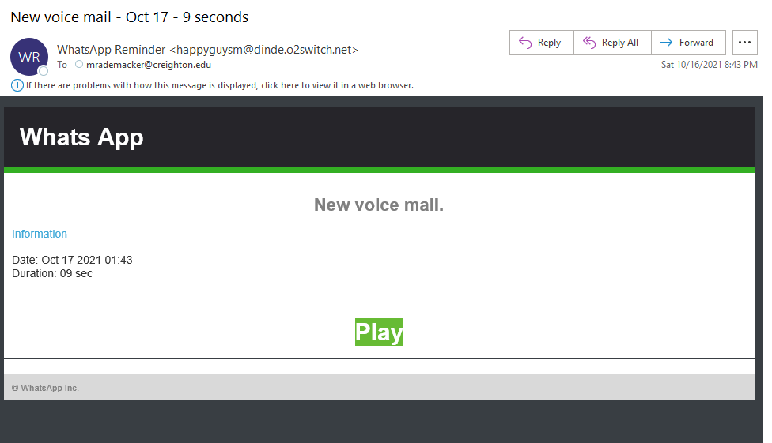
Information Security

Slide 23
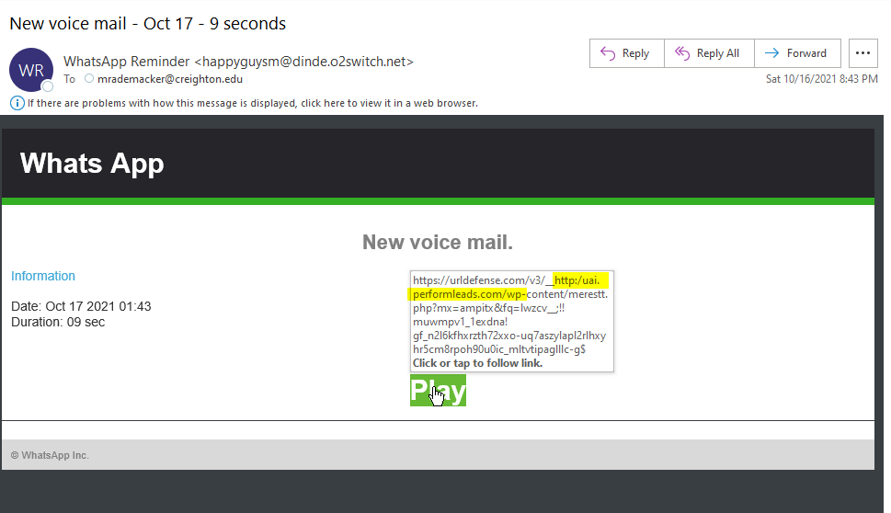
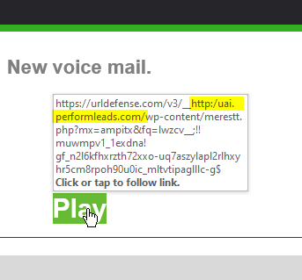
Information Security

Slide 24
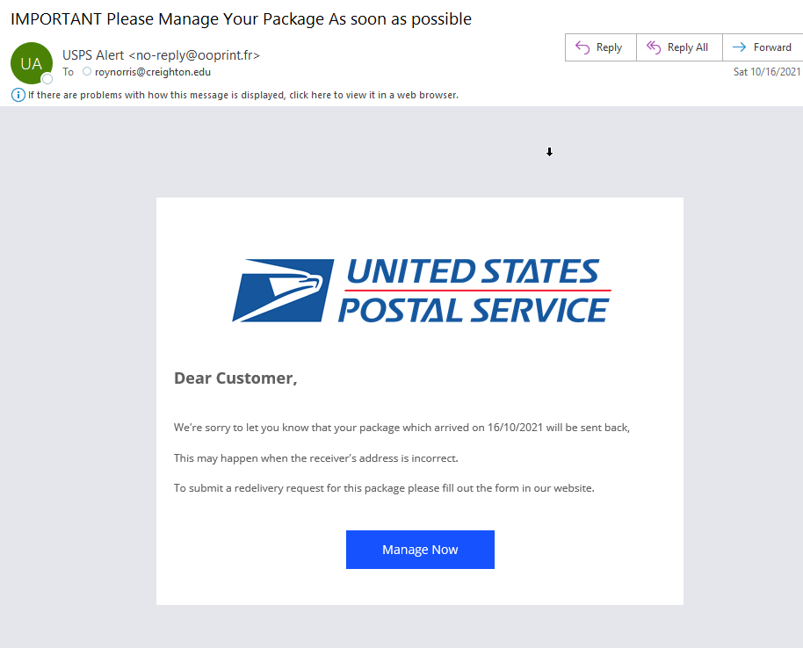
Information Security

Slide 25
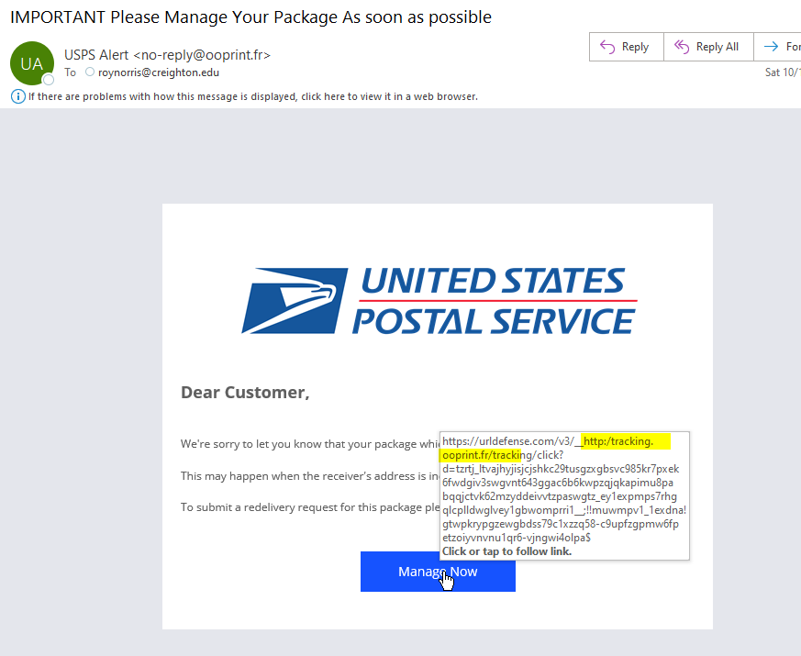
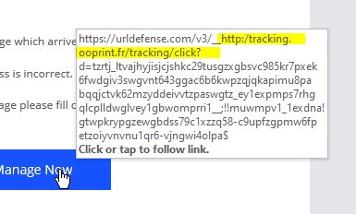
Information Security

Slide 26
How to spot a Phishing email?
Is this a phishing Email?
Information Security

Slide 27
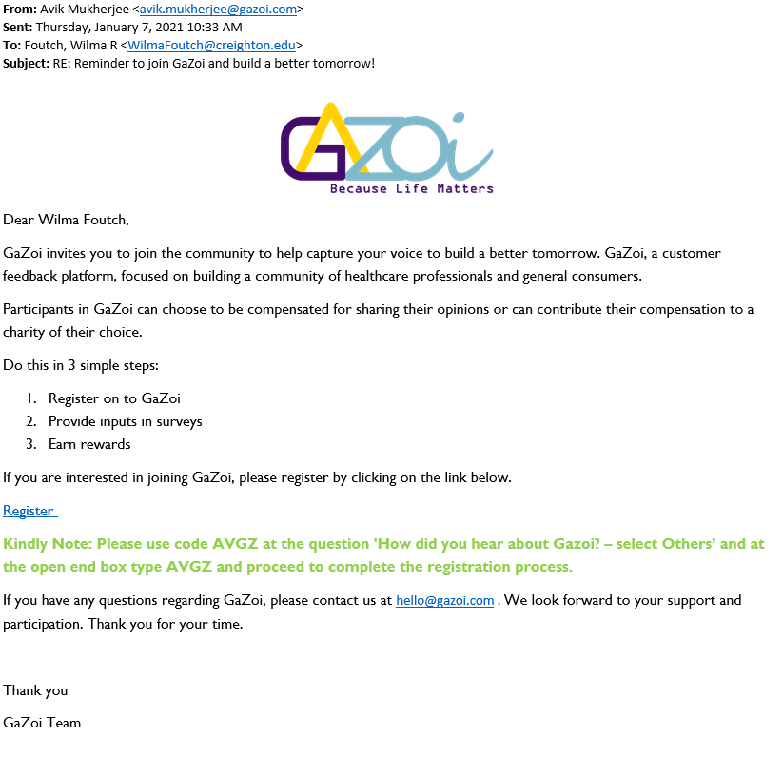
Information Security

Slide 28
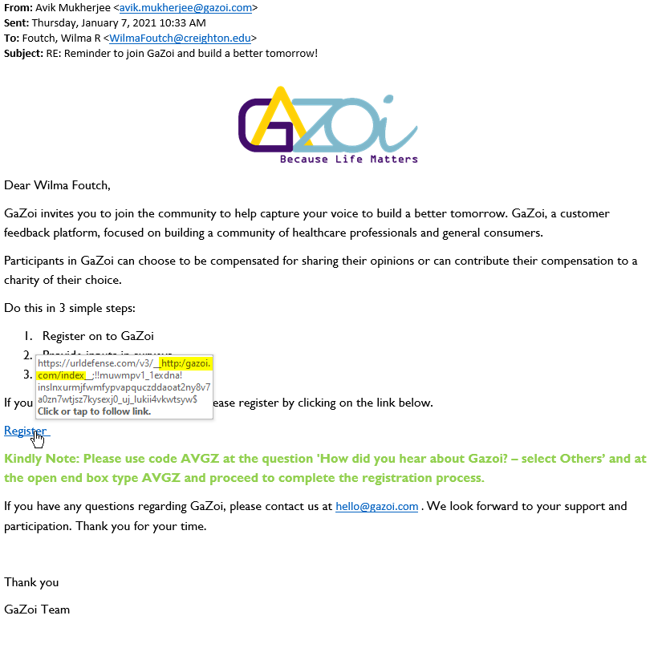
Information Security

Slide 29
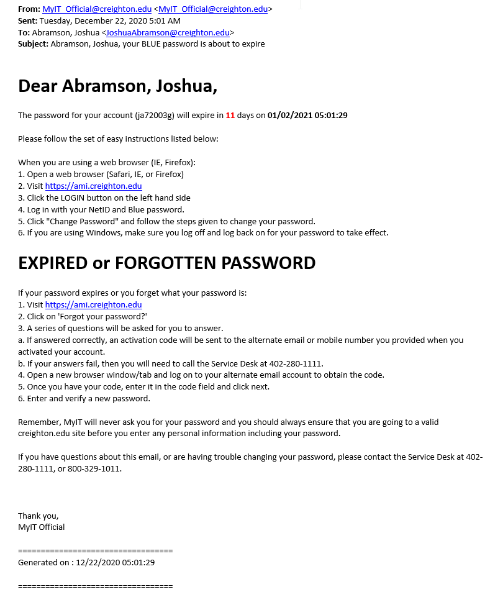
Information Security

Slide 30
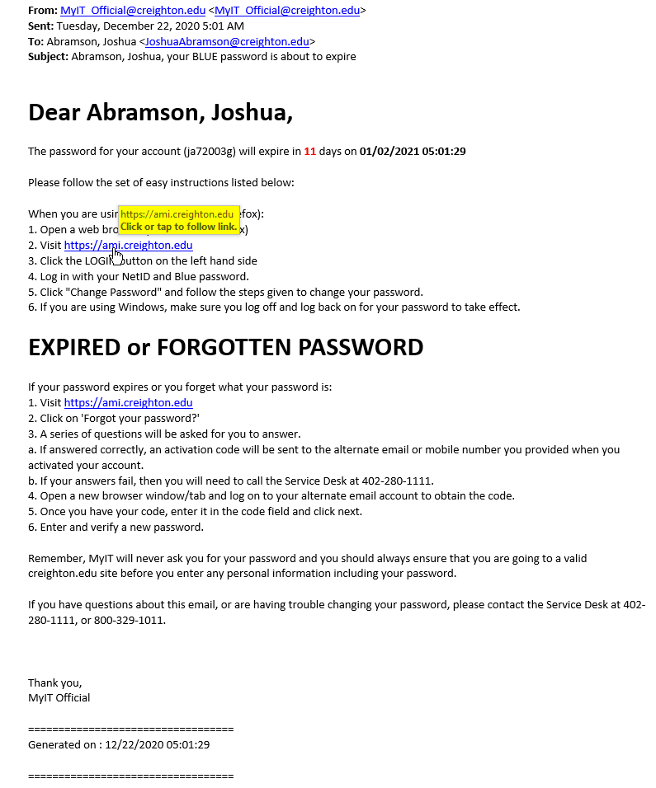
Information Security

Slide 31
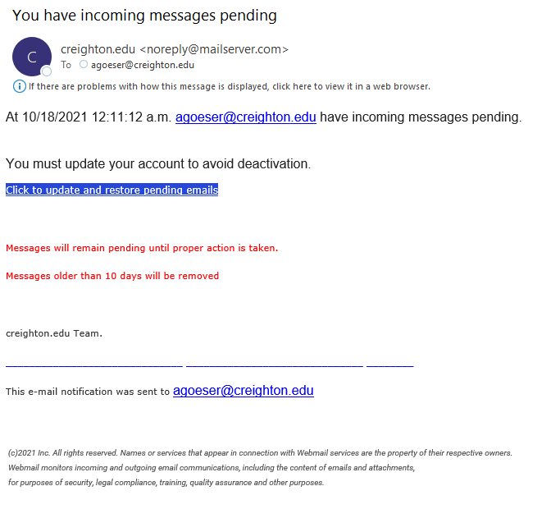
Information Security

Slide 32
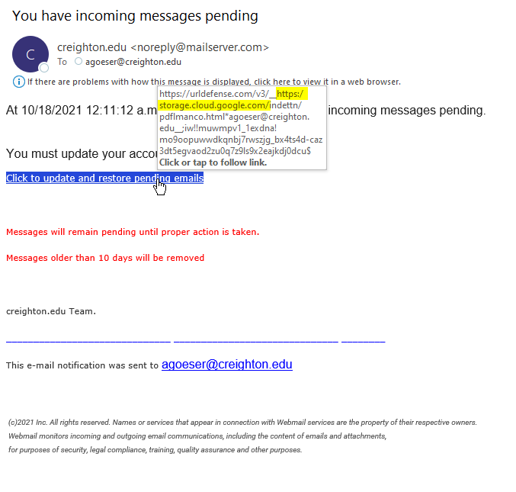
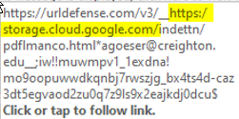
Information Security

Slide 33
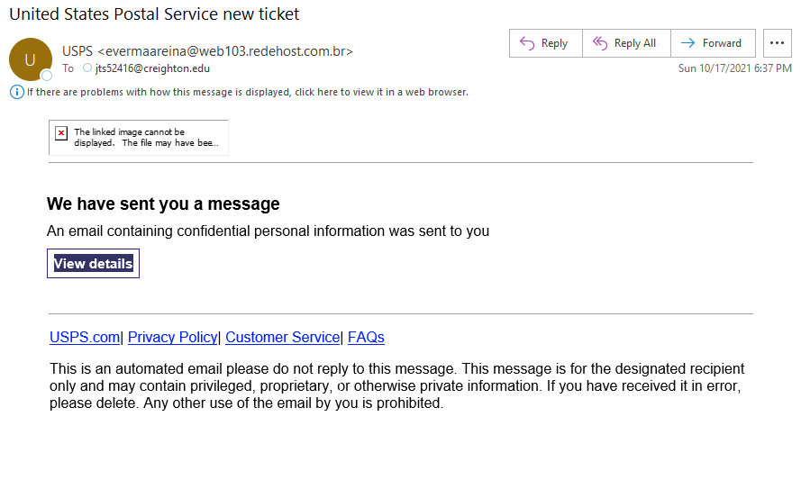
Information Security

Slide 34
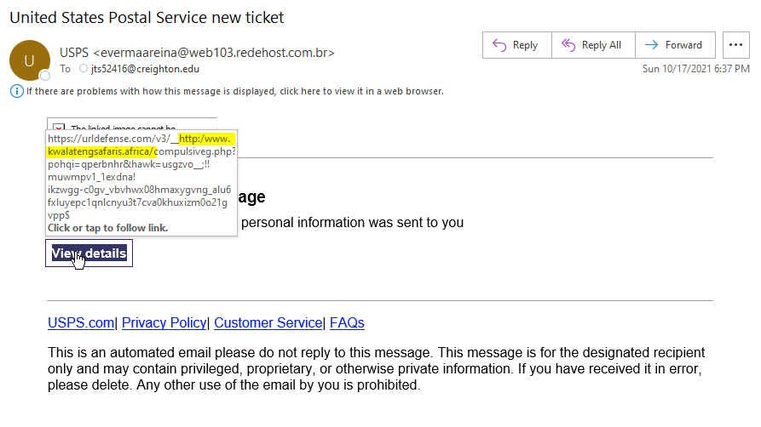
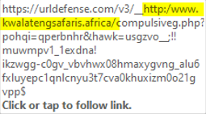
Information Security

Slide 35
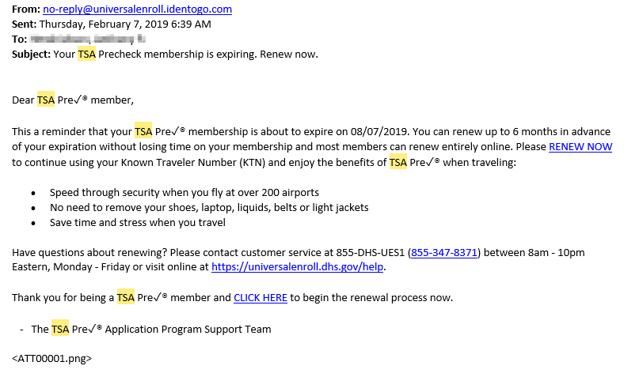
Information Security

Slide 36
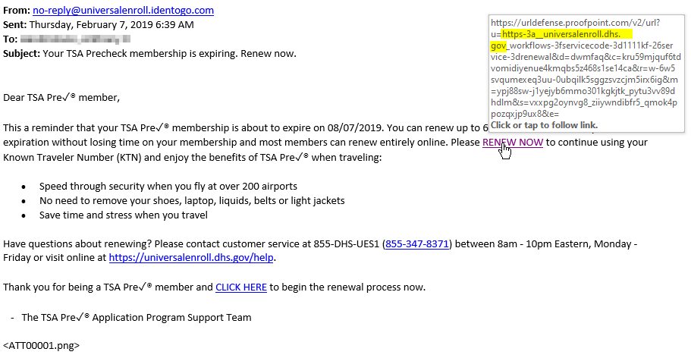
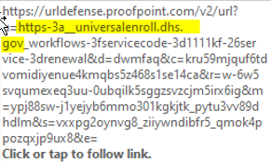
Information Security

Slide 37
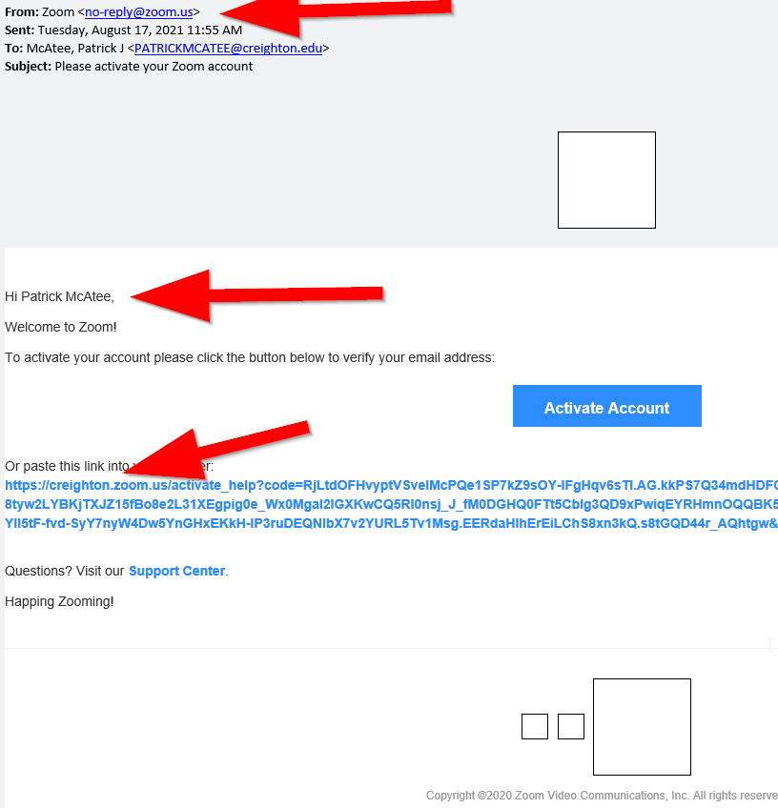
Information Security

Slide 38
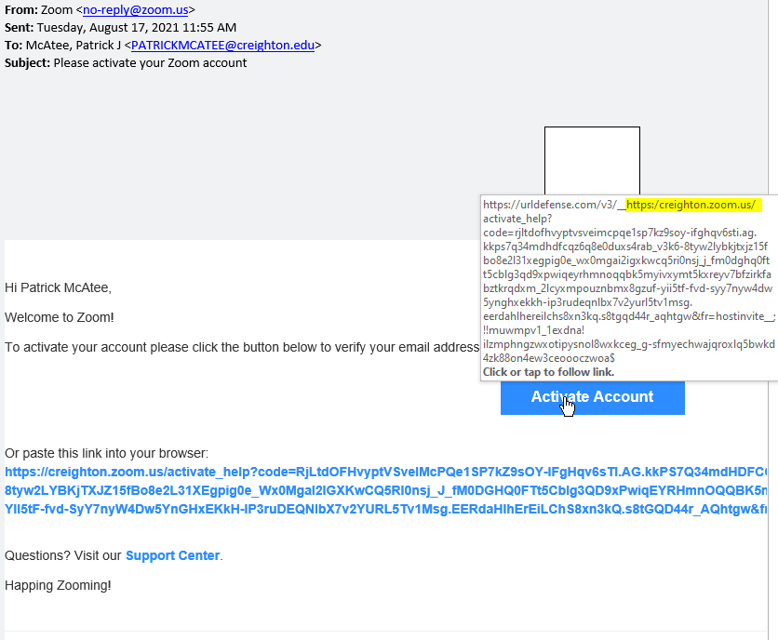
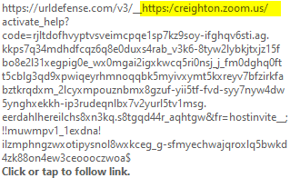
Information Security

Slide 39
Most dangerous Phishing Emails
Be aware of phishing emails with file attachments
NEVER open an attachment that you were not explicitly expecting
Information Security

Slide 40
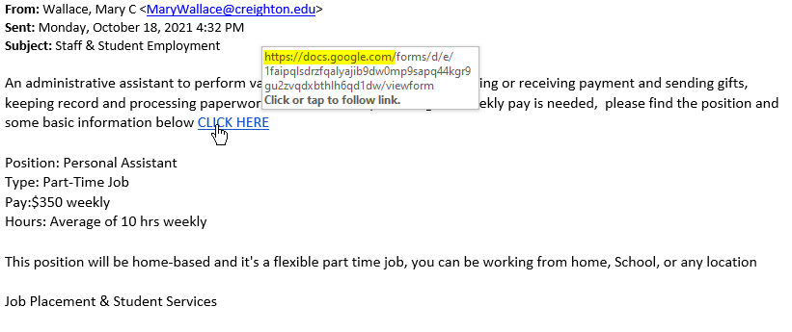
Most dangerous Phishing Emails
Be aware of phishing emails from internal accounts
Information Security

Slide 41
Strong Passwords
Information Security

Slide 42
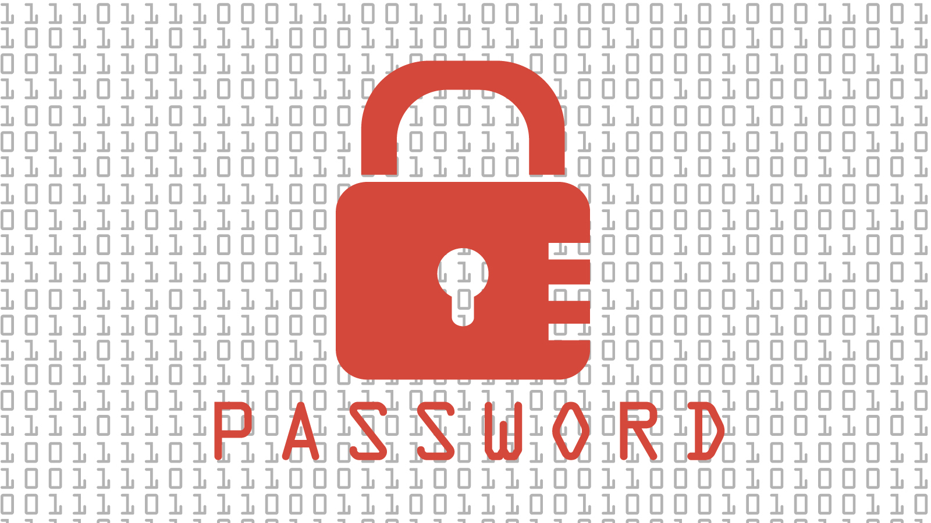
Strong Passwords
Passwords MUST be easy to remember but hard to guess.
Length is better than complexity.
Must change your password to something completely different that previous password.
Don’t use your BLUE password elsewhere.
Information Security

Slide 43
Hard to Guess Passwords
Passphrase, passphrase, passphrase
a string of words that must be used to gain access to a computer system or service
horse blue3 Acrobat shoe (24 chars)
chinaStaybrownelephant@ (23 chars)
violin 5chimps Drum Oysters (27 chars)
Bad passphrases use words too related to each other or too personal
My birthday is Aug. 13th (BAD PASSPHRASE)
Blue green Red yellow1 (BAD PASSPHRASE)
Information Security

Slide 44
Change you Password
Change your password every six months, or
If you suspect your password has been compromised.
ALWAYS change your password to something completely different
I like strawb3rry ice cream (Decent 27 char passphrase)
I like strawb3rry ice cream2 (BAD 28 char passphrase)
I like strawberry ice cream3 (ROTTEN passphrase)
I like strawb3rry ice cream4 (HORRIBLE passphrase)
Information Security

Slide 45
Don’t use your BLUE password elsewhere
Never reuse your BLUE password on other sites.
Information Security

Slide 46
Not Using a Password Vault
A password vault can ease password sprawl.
A password vault can improve password strength.
A password vault can improve and speed password use.
Information Security

Slide 47
Password Vault
Could require you to only remember 2-3 passwords, allowing the vault to remember the rest.
Can securely ‘enter’ passwords on your behalf
Is far more secure that writing them down or reusing the same password.
Information Security

Slide 48
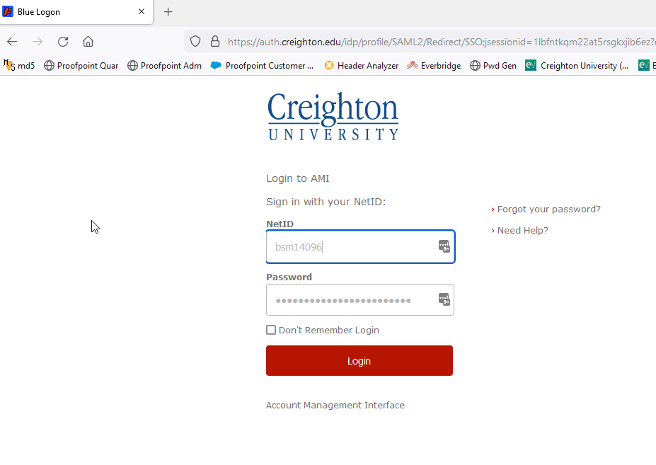
Password Vault
Information Security

Slide 49
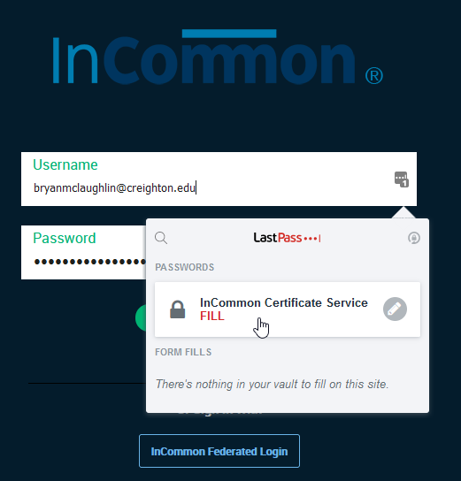
Password Vault
Information Security

Slide 50
What the Division of IT is doing to protect the campus

Slide 51
What is DoIT Doing?
Continuing Security Awareness Training
Student MFA
Security Operations Center
Improved vulnerability management
Enhanced network security
Improved Identity and Access Management
Information Security

Slide 52
Questions?
Information Security
52

